Slide 1
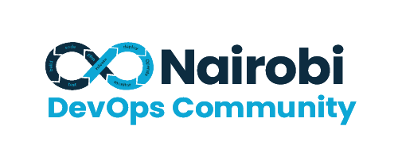
IAC USING CROSSPLANE
In-depth insight into how Cross-plane has the potential to revolutionize and enhance your IAC processes
By Brian Tarno and Winnie Gakuru

Slide 2
Introduction
When Kubernetes was open-sourced by Google on July 21, 2014, and subsequently turned over to the Cloud Native Computing Foundation (CNCF) in 2015 to be developed and managed as an open-source project, This Opened up a number of innovations around it as new projects leveraged the Kubernetes API capability and extensibility.
1

Slide 3
What is Kubernetes API?
According to the Kubernetes’ official documentation
“… The core of Kubernetes’ control plane is the API server. The API server exposes an HTTP API that lets end users, different parts of your cluster, and external components communicate with one another. The Kubernetes API lets you query and manipulate the state of API objects in Kubernetes (for example: Pods, Namespaces, ConfigMaps, and Events)”
The Kubernetes API can be extended in one of two ways:
Custom resources (CRD) let you declaratively define how the API server should provide your chosen resource API.
You can also extend the Kubernetes API by implementing an aggregation layer.

Slide 4
CRDs vs. Controllers vs Operators
CRDs allow you to define custom resources, controllers manage the lifecycle of resources, and Operators are a specialized type of controller that automates the management of complex applications by extending the Kubernetes API. Together, these concepts provide a powerful framework for extending and customizing Kubernetes for diverse workloads.
1

Slide 5
What is Crossplane?
Crossplane is an open-source project that extends the Kubernetes API to allow users to manage infrastructure resources alongside application workloads.
Crossplane extends the Kubernetes API, providing a unified API for both infrastructure and applications. This allows for a consistent and familiar interface for managing all resources within a Kubernetes cluster.
1

Slide 6
Why Crossplane?
Multi-cloud and Hybrid Cloud Support:
It provides a consistent interface for managing resources across multiple cloud providers, including AWS, Azure, GCP, and more
State Management:
Since the control plane is built on top of Kubernetes, no additional effort is required to manage a state like Terraform, as the state is handled internally by etcd database
Drift Detection:
Crossplane is natively built on top of Kubernetes and hence it supports native capabilities such as Drift detection and reconciliation
Infrastructure as Code (IaC):
Crossplane allows you to define and manage cloud infrastructure and services as code.
Infrastructure Composition:
With Crossplane, you can compose infrastructure resources and services into higher-level abstractions.
Observability and Control:
Crossplane provides observability features to monitor the state and health of provisioned resources.
API-driven Automation:
Crossplane exposes a powerful API that can be used for automation and integration with other systems.
Immutable Infrastructure:
Crossplane promotes the concept of immutable infrastructure, where infrastructure resources are treated as immutable and not modified directly

Slide 7
Crossplane vs Terraform?
The choice between Crossplane and Terraform depends on your specific requirements and the context of your infrastructure management. Crossplane is more tightly integrated with Kubernetes and is suitable for organizations with a strong focus on Kubernetes-native workloads, while Terraform provides a broader infrastructure management solution that is not limited to Kubernetes environments.
Description

Slide 8
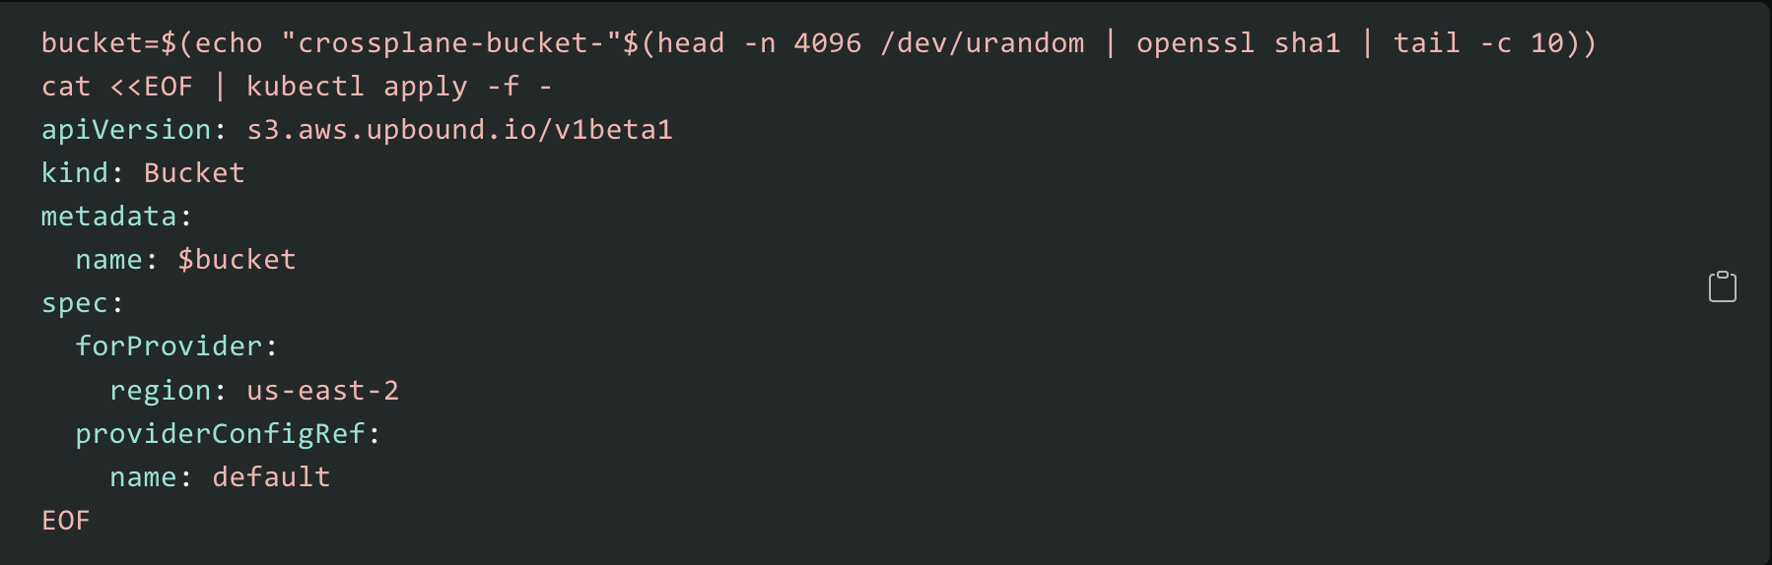
Managed resourced

Slide 9
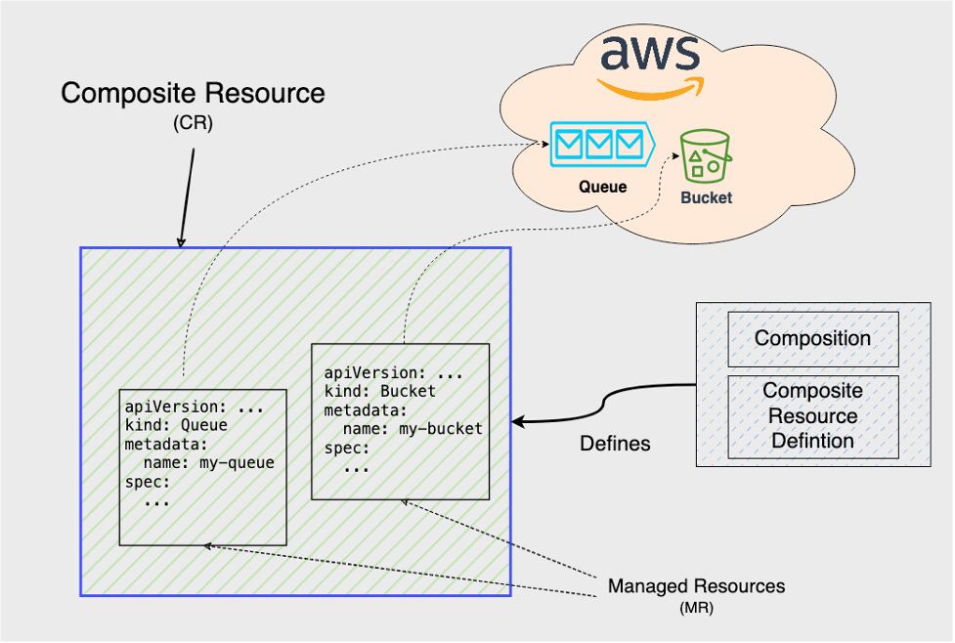
How it works?
01
A Provider’s CRDs map to individual resources inside the provider. When Crossplane creates and monitors a resource it’s a Managed Resource.
Using a Provider’s CRD creates a unique Managed Resource. For example, using the Provider AWS’s bucket CRD, Crossplane creates a bucket Managed Resource inside the Kubernetes cluster that’s connected to an AWS S3 storage bucket.
The Crossplane controller provides state enforcement for Managed Resources. Crossplane enforces the settings and existence of Managed Resources.
Description

Slide 10
Crossplane components overview
Component | Abbreviation | Scope | Summary
Provider |  | cluster | Creates new Kubernetes Custom Resource Definitions for an external service.
ProviderConfig | PC | cluster | Applies settings for a Provider.
Managed Resource | MR | cluster | A Provider resource created and managed by Crossplane inside the Kubernetes cluster.
Composition |  | cluster | A template for creating multiple managed resources at once.
Composite Resources | XR | cluster | Uses a Composition template to create multiple managed resources as a single Kubernetes object.
CompositeResourceDefinitions | XRD | cluster | Defines the API schema for Composite Resources and Claims
Claims | XC | namespace | Like a Composite Resource, but namespace scoped.

Slide 11

Crossplane in Action
1
Demo by Winnie Gakuru

Slide 12

Q/A ?

